Slide 1

Minor Project review
PROJECT TITLE:
AUTOMATIC WATER SUPPLIER FOR PLANTS
TEAM MEMBERS:
U.S.VARSHINI (927622BEC243)
P.SRINITHI (927622BEC204)
P.SUBASREE (927622BEC207)
D.SUBHIKA (927622BEC209)
GUIDED BY:Mrs.ABIRAMI M.E.,(Ph.D)

Slide 2
“EVERY GREEN TREE IS FAR MORE GLORIOUS THAN IF IT WERE MADE OF GOLD AND SILVER”

Slide 3
PROBLEM STATEMENT
Due to our buzy schedules in life, we may forget to water our plants .
It leads the plants to death.
So that this automatic water supplier for plants helps to water the plants and promoting health.

Slide 4
OBJECTIVES
1. To efficiently and precisely meet the water requirements of plants.
2. To automate the watering process, ensuring consistency, preventing overwatering or underwatering.
3. To reduce the manual effort required for plant care and enhances the overall wellbeing of the plants
4. To detect , monitor and control pest using esp32 cam

Slide 5
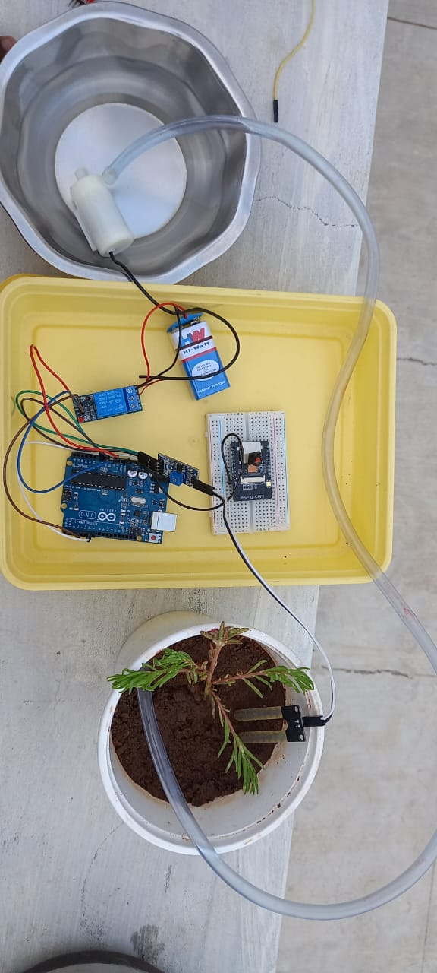
CIRCUIT DIAGRAM

Slide 6
COMPONENTS USED
Arduino uno board
Soil moisture sensor
Pump
Relay module
Battery
Esp 32 cam

Slide 7
EXISTING SYSTEM
Drip irrigation
Self watering plants
Smart irrigation controllers
Micro controller based DIY setups
Hydroponiuc systems

Slide 8
PROPOSED SYSTEM
The proposed automatic water supply system integrates advanced sensors and IoT technology for precise monitoring.
The scalable system promotes sustainability through smart water management, ensuring reliable and automated water supply.
It also use compactable esp32 cam for monitoring the plant health and control pest

Slide 9
PLAN OF WORK COMPLETION
As for now we have completed the automatically water supplying system depending upon the soil moisture level using soil moisture sensor.
And we also integrated the esp32 wifi board cam with this system to detect the pest and monitor the plant growth.
Furthermore, we have an idea to implement a fertilizer injector hat can inject liquid fertilizer into the water supply, providing plants with nutrients during watering cycles.

Slide 10
CONCLUSION
The automatic water supplier for plants is a system which is designed efficiently and autonomously fulfill the watering needs of plants
It is our duty to conserve both the water and plants. But, due our busy schedules, we may often forget to do that.
By using this automatic water supply system we may conserve both the plants and water in a effective manner.

Slide 11
REFERENCES
1. Saseendran, S., Nithya, V. (2016). Automated water usage monitoring system. Publisher: IEE, 2016. Conference Location: Melmaruvathur, India
2. Stonecypher, L. (2015). Building an Electronic Water Level Controller. 2015.
3. Swagatam. (2015, 4 July). Build This Simple Electronic Water Level Controller. Retrieved from http://www.brighthubengineering.com/consum er-appliances-electronics/68342-build-thissimple-electronic-water-level-controller/
4. Raheja, D.K. (2017, 15 September). Automated Water Pump Motor Controller. Retrieved from http://electronicsforu.com/electronicsprojects/automatic-water-pump-motorcontroller
5. Seed Wiki. (2017). G1/2 Water Flow Sensor. Retrieved from http://wiki.seeedstudio.com/wiki/G1/2_Water _Flow_ sensor
6. Wikipedia. (2017). Level Sensor. Retrieved from https://en.wikipedia.org/wiki/Level_sensor

